Slide 1
General Biology (Biol1012)
Lecture Slides
Chapter 7. Taxonomy of Organisms
1

Slide 2
Unit 7. Taxonomy of organisms
Taxonomy is derived from two Greek words:
"taxis", which means arrangement and
"nomos" which means law
Thus, taxonomy means the law governing the classification or arrangement of organisms into taxa (taxonomic groups)
it is mainly concerned with description, classification, nomenclature and identification of organisms.
Description: assignment of features to an organism
Classification: ordering of organisms into hierarchy of ranks based on similarities/phylogenetic relationships
Nomenclature: naming of taxonomic groups/taxa according to some standardized system (i.e. allocation of name of the taxa produced)
Identification: assignment of an organism or specimen to an existing classification/by reference to an already existent classification

Slide 3
Early Attempts to Classify Organisms
The development of modern taxonomy has not a linear path.
Naming, describing & classifying living organisms are natural & integral activity of humans. Without such knowledge, it would be difficult to communicate.
Phases of developmental stages of taxonomy:
A. Pre-Linnaean
Ancient taxonomy
Ancient people have grouped/ categorized living things into categories & gave common names = Folk Taxonomy
Characterized by existent & no-existent of common names
Important for communication of the people

Slide 4
Early Attempts to Classify Organisms …
ii) Greek and Roman Philosophers=Essentialists
Tried to classify organisms based on selected/more essential characteristics
Aristotle (384–322 BC)
Aristotle viewed life was hierarchical and he classified organisms
the first to classify living things into plants & animals
Animals: into “animals with blood” & “animals without blood”
animals with blood: live-bearing & egg-bearing,
Animals without blood: insects, crustacea and testacea (molluscs)

Slide 5
Early Attempts to Classify Organisms …
b) Theophrastus (370-285 BC)
He was the first taxonomist to write down a classification in a logical form
Classified of all known plants at that time, in his book “De Historia Plantarum”,
He classified 480 kinds of plants based on their habit/growth form
Plants were classified as trees, shrubs/herbs
However, his work incorporates the principle of the rules of Dichotomy or Excluded Middle
According to Theophrastus classification system, there are no any intermediate organisms
Any given organisms is either A or not A
He was typologists, belief that every natural group of organisms has an invariant, generalized or idealized pattern shared by all members of the group

Slide 6
Early Attempts to Classify Organisms …
c) Pliny the Elder (23-79 A.D.)
Naturalist who wrote books termed Historia naturalis
Categorized plants in terms horticultural practices medicinal uses, and timber use practices
described several plants & gave them Latin names.
Many of these names are stil in use (e.g. Populus alba & Populus nigra)
Some call him the Father of Botanical Latin.
d) Dioscorides (40–90 AD)- Greek physician
Wrote a book entitled “De Materia Medica” ≈ 600 plant species with their useful application (mostly medicinal uses).
Used in medicine until the 16th C
classification based on medicinal properties
e) Caesalpinus (1519-1603)
In his book "De Plantis" he illustrated about 1500 plant species
He classified plants based on definite morphological criteria mainly on the basis of habit, fruits, seeds, and ovaries and ovary positions

Slide 7
Early Attempts to Classify Organisms …
f) Bauhin J. (1554-1631)
Recognize genera and species as major taxonomic levels
Used a binary nomenclature composed of the genus name followed by a single specific
B. Linnaean Era (1707-1778)= Sexual system of classification
Considered as the father of modern taxonomy
Briefly described the genera and the species in his books “Genera Plantarum (1737) and Species Plantarum (1753)”
Binomial nomenclature: system of nomenclature in which two terms are used to denote a species name (genus name and specific name /specific epithet.
His classification system was artificial-which depends only on few characteristics like stamens and pistil numbers & position.
Linnaeus developed a hierarchical system of classification

Slide 8
C. Post-Linnaean Taxonomy= Natural system of classification
The foundation of modern classification comes mainly after the the works of other taxonomists M. Adanson (1727-1806), De Jussieu (1748-1836), and J. de Lamarck (1744-153 1829), A.P. de Candolle and C. Darwin (1859), who never followed artificial system of Linnaeus classification.
M. Adanson (1727-1806)
Championing the idea that in classification one should use a great range of characteristics without placing greater emphasis on some than on others=Natural system of classification
Empirical approach. Adanson was a severe critic of Linnaeus' works

Slide 9
Modern Views of Classification/Schemes of Classification
Classification system of diversified organisms depends up on the combined evidences:
Morphology
Ultrastructure and
Molecular phylogeny
1. Artificial classification system
In this system, only one or at most a few characters are selected for use in making comparison among organisms
Ranking is done subjectively
Artificial system is monothetic
Possession of unique set of characters/features is both sufficient and necessary for membership in the group defined
Classifications followed by Theophrastus and Linnaeus are good example of artificial system of classification

Slide 10
2. Natural classification system
This classification system is based up on several to many characters selected for their value
This system is therefore polythetic
it places together organisms that have the greatest number of shared features
NO single feature is either essential to group membership or is sufficient to make an organism a member of the group
Classification system by Adanson and De Jussieu are good examples of natural classification system

Slide 11
3. Phyletic or Evolutionary classification system
It is a classification that aims at reconstructing a sequence starting with the most primitive character and ending with the most advanced or derived character
It ensures that each taxon recognized as a monophyletic i.e. has arisen by the diversification of a single ancestor
According to phyletic classification system,

Slide 12
4. Phenetics classification system
According to Harrison (1960), the word "Phenetic" is to mean a relationship by overall similarity of all available morphological characters
Thus, similarity/resemblance is determined based on a set of phenotypic characteristics of organisms (numerous characters with equal weight)
The following methods/approaches are used for determining the similarity of the organisms under study
Selection of taxa-called Operational Taxonomic Units (OTUs) for study. These may be species, genera or families.
Selection of character states (minimum of 60 and 80 -100 are desirable for comparisons)
Description or measurement of character states
Ranking of all OTUs into the categories of the taxonomic hierarchy

Slide 13
5. Phylogenetic classification system
is the concepts and methods of determining similarity by constructing branching patterns of evolution
The method works as follows:
Select monophyletic taxa (descended from common evolutionary ancestor)
Select characters of evolutionary interest
Describe and/or measure character states
Determine homologies of characters and character states
Generate trees or cladograms
Once the cladogram or tree of life is generated, it is possible to construct classification based upon the cladogram

Slide 14
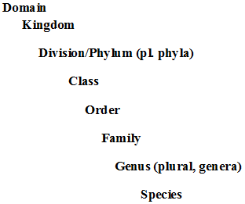
Domains of Life & Hierarchical System of Classification
Hierarchical System of Classification
An arrangement of taxa into an ascending series of ever–increasing inclusiveness forms
In a hierarchical system, we start at the bottom with individuals (species) and end up at the top with one all-embracing taxon (Domain)
The major levels in the hierarchy are the following

Slide 15
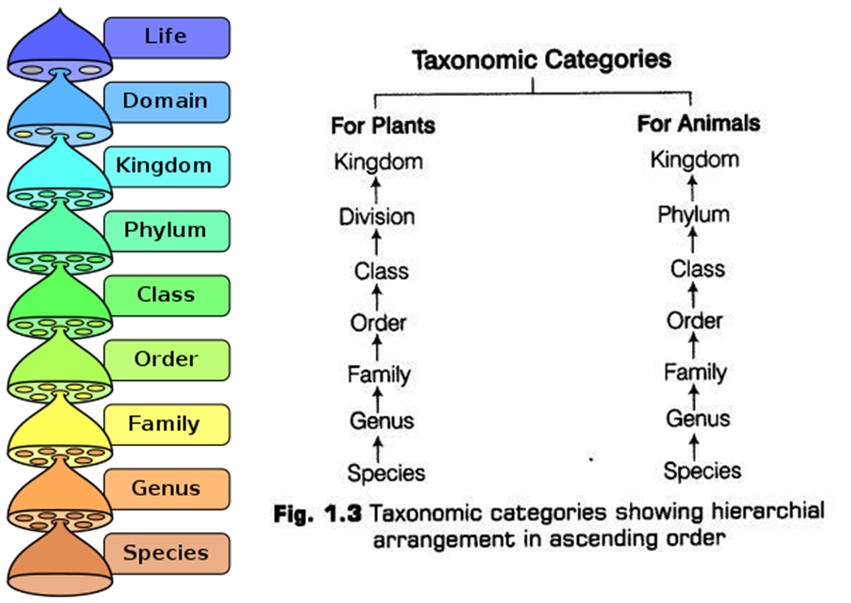

Slide 16
Concepts of the Kingdom
Different kingdom systems have been introduced during different developmental stages of taxonomy
Number of of kingdom has increased from 2 to 5 or 6/7.
i) Two kingdom approach:
kingdom animalia -living thing that moved, ate, and grew to a certain size
Kingdom plantea - living thing that did not move or eat and that continued to grow
Mode of nutrition and presence or absence of cell wall.

Slide 17
ii) Three Kingdoms
A third kingdom, protista (unicellular) was proposed by Ernst Haeckel in 1866.
Whether organisms are unicellular (Protista) or multicellular (Animals and Plants).
Three Kingdom System: Kingdom Protista, Kingdom Plantae and Kingdom Animalia.

Slide 18
III. Four kingdoms
The result of the discovery of the electron microscope
A four-kingdom was proposed by Copeland in 1938
Prokaryotes (bacteria and blue green algae =kingdom Monnera) and eukaryotics (plantae, Animalia & Protista) were distinguished
Initiated the rank above kingdom, a super-kingdom/ empire/ domain = Prokaryot vs Eukaryta

Slide 19
IV. Five kingdoms
Proposed by Whittaker in 1969
Formation of the 5th kingdom was based mainly on differences in nutrition; multicellular saprotrophs (saprophytes) formed the kingdom Fungi
Fungi are prokaryotic, no chlorophyll & they contain chitin in their cell wall.
Thus, Kingdom Monera (prokaryotic) + Eukaryotics (Kingdoms Protista, Plantae, Fungi and Animalia )

Slide 20
VI. Six Kingdoms
Based on such RNA studies, Carl Woese (1977) divided prokaryotes (Kingdom Monera) into Eubacteria & Archae bacteria.
Kingdom Bacteria, Archae, Protista, Plantae, Fungi & Animalia
Life | Domain Bacteria | Kingdom Bacteria
 | Domain Archaea | Kingdom Archaea
 | Domain Eukarya | Kingdom Protista
 |  | Kingdom Plantae
 |  | Kingdom Fungi
 |  | Kingdom Animalia

Slide 21
The Three-Domain System
As biologists observed differences between two kinds of prokaryotes, they saw similarities among eukaryotes.
A new system divided all organisms into three domains: Bacteria, Archaea, and Eukarya.
Today, most biologists tentatively recognize three domains and six kingdoms.

Slide 22
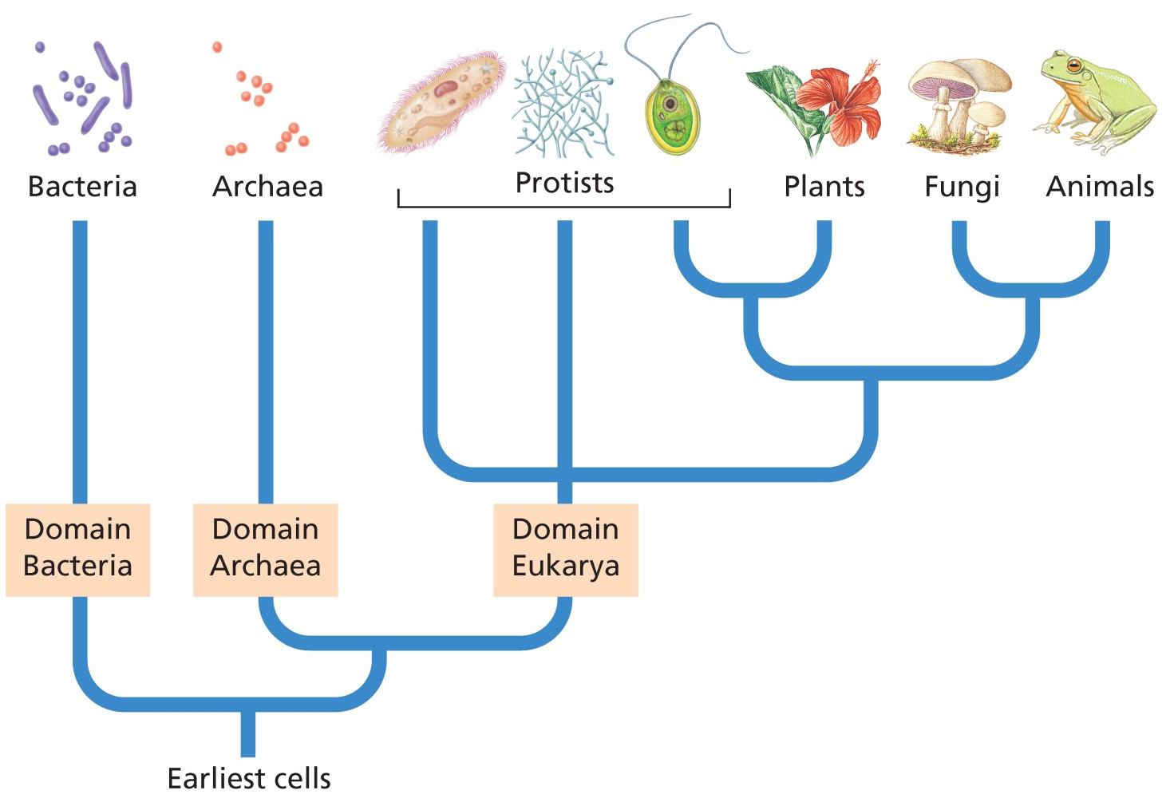
Phylogenetic diagram of major groups of organisms

Slide 23
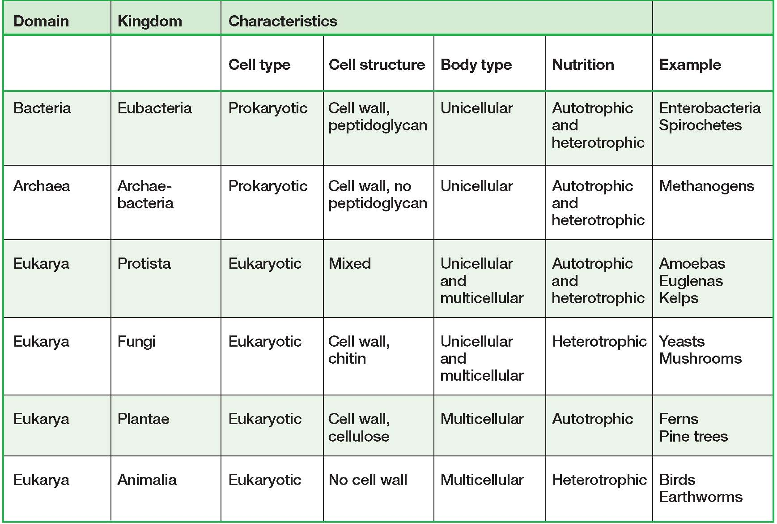
Kingdom and Domain Characteristics

Slide 24
Binomial Nomenclature
Nomenclature is the naming of organisms and the rules governing the application of these names
In nomenclatural system, each organism is designated by two names
the first is the name of the genus
the second is the specific epithet (in Botany)/specific names (Zoology)
No two species can have the same scientific name.
The names are always Latin (or Latinized) and the genus is capitalized while species name is not

Slide 25
The Purpose of giving names to organisms
Name is a conventional symbol or code that serves as a means of reference
Purpose
Easy communication
Avoids the use of an inconvenient descriptive phrase
To universalize the organism
For this reason sets of rules have been drawn up
International Code Botanical Nomenclature (ICBN)
International Code of Zoological Nomenclature (ICZN)
International Code of Nomenclature of Bacteria
International Code of Nomenclature for Cultivated Plants
International Organizations & Unions for the Stabilization of Changes

Slide 26
Operative Principles of Nomenclature
Operative Principles of Nomenclature
The nomenclature code has set certain provisions, called Operative Principles of Nomenclature. These provisions are
Publication
Typification and
Priority
Publication
Publication is the means by which scientific names enter to the biological nomenclature system
Two basic conditions must be fulfilled before a properly formulated scientific name
The name must be published in works that are printed in permanent and made available to the interested public
A name must be accompanied by a written matter or a reference to such description

Slide 27
Typification
A type is an element on which the description associated with the original publication of a name was based
In nomenclature, there are different kinds of "Types". Some of these are:
Holotype
It is the sole element used or designated by the author of a name as a type
Isotype
The duplicates of a holotype (collected specimen at the same time by the same person from the same population).
Syntype
Any one of two or more elements used by the author of a name who did not designate a holotype (when more than one specimen are cited by the author without mentioning about the holotype)
Lectotype
Is an element selected subsequently from amongst syntypes to serve as a type
Neotype
An element selected to serve as a nomenclatural type when through loss or destruction of the above "Types“

Slide 28
Priority of publication
The principle of priority requires when two or more names apply to the same taxon
In this case, the name is given generally based up on by the oldest one, which is validly published name
In nomenclature, when two or more names are applied the same taxon, it is known as synonyms (i.e. the synonyms are rejected name as only one scientific name is accept as correct name)
There are two kinds of synonyms
Nomenclatural
based on the same ‘ type‘ of the organism and called obligate or homotypic synonyms
2. Taxonomic synonyms
based on different ‘ type‘ of an organism, and called heterotypic synonyms

Slide 29
Authorities and Their Citations
The scientific names of organisms are often written followed by one or more personal names / author name, who first published the name in the way that satisfies the criteria of valid publication or available names.
Sometimes the names of the authors are abbreviated
e.g. Rumex abyssinicus Jacq., Plantago lanceolata L.
Sometimes, double citations are required due to change in taxonomic position or rank.
e.g. Carissa edulis Vahl. was later changed to Carissa spinarum (Vahl.) L. by Linnaeus .

